Slide 1
Introdução às tecnologias Web - ITW
Pratica 5 – Utilização da biblioteca Twitter Bootstrap no desenvolvimento web

Slide 2
Projeto
Utilizando o bootstrap crie um conjunto de páginas web destinadas à presença institucional de uma empresa constituída por 3 páginas principais:
* Página de entrada (index.html)
- Banner promocional
- texto de identificação da empresa
* Página de produtos (produtos.html)
- Lista de produtos da empresa e uma pequena descrição de cada um deles (3 colunas – ecrã grande / 2 colunas – ecrã médio / 1 coluna – ecrã pequeno);
* Página de contactos (contactos.html)
- vários endereços das delegações da empresa
-oOo-
Procure as facilidades do Bootstrap de modo a melhorar a interface e tirar as potencialidades todas; Não se esqueça que a interface deve ser adaptável aos diversos tipos de dispositivos – monitor, tablet e móvel.
https://getbootstrap.com/docs/5.3/getting-started/introduction/

Slide 3
Exercise (English version of previous slide)
Using the bootstrap create a set of web pages for a company institutional presence consisting of 3 main pages:
* Home page (index.html)
- promotional banner
- company identification text
* Products page (products.html)
- List of company products and a short description of each of them (3 columns – large size / 2 columns – medium size / 1 column – small size);
* Contacts page (contacts.html)
- several addresses of the company's delegations
.oOo.
Search for Bootstrap's facilities to improve the interface and take advantage of all of them; Do not forget that the interface must be adaptable to the different types of devices - monitor, tablet and mobile.
https://getbootstrap.com/docs/5.3/getting-started/introduction/

Slide 4
Ajudas / Add-ons
Instalação do Bootstrap no Visual Studio / Bootstrap installation on Visual Studio

Slide 5
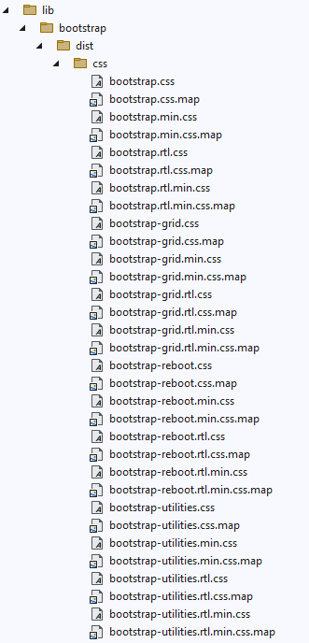
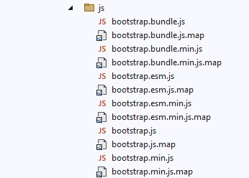
❶ libman.json ❷
{
"version": "1.0",
"defaultProvider": "cdnjs",
"libraries": [
{
"destination": "wwwroot/lib/bootstrap/dist/",
"library": "bootstrap@5.2.2"
},
{
"destination": "wwwroot/lib/font-awesome/dist",
"library": "font-awesome@4.7.0"
}
]
}

Slide 6
Ficheiro base / Base file Bootstrap + Google Fonts + Font Awesome – local files
<!doctype html>
<html lang="en">
<head>
<!-- Required meta tags -->
<meta charset="utf-8">
<meta name="viewport" content="width=device-width, initial-scale=1, shrink-to-fit=no">
<!-- Google Fonts -->
<link rel="preconnect" href="https://fonts.googleapis.com">
<link rel="preconnect" href="https://fonts.gstatic.com" crossorigin>
<link href="https://fonts.googleapis.com/css2?family=Open+Sans&display=swap" rel="stylesheet">
<!-- Bootstrap CSS -->
<link href="../lib/bootstrap/dist/css/bootstrap.min.css" rel="stylesheet" />
<!-- Font Awesome -->
<link href="../lib/font-awesome/dist/css/font-awesome.min.css" rel="stylesheet" />
<title>Using Bootstrap</title>
<style>
body {
font-family: 'Open Sans', sans-serif;
}
</style>
</head>
<body>
<!-- Bootstrap Bundle -->
<script src="../lib/bootstrap/dist/js/bootstrap.bundle.min.js"></script>
</body>
</html>

Slide 7
Ajudas / Add-ons
Instalação do Bootstrap no Visual Studio / Bootstrap install on Visual Studio
Fontes externas / Remote sources

Slide 8
Ficheiro base / Base file Bootstrap + Google Fonts + Font Awesome – remote files
https://www.jsdelivr.com/package/npm/bootstrap
<!doctype html>
<html lang="en">
<head>
<!-- Required meta tags -->
<meta charset="utf-8">
<meta name="viewport" content="width=device-width, initial-scale=1, shrink-to-fit=no">
<!-- Google Fonts -->
<link rel="preconnect" href="https://fonts.googleapis.com">
<link rel="preconnect" href="https://fonts.gstatic.com" crossorigin>
<link href="https://fonts.googleapis.com/css2?family=Open+Sans&display=swap" rel="stylesheet">
<!-- Bootstrap CSS -->
<link rel="stylesheet" href="https://cdn.jsdelivr.net/npm/bootstrap@5.3.2/dist/css/bootstrap.min.css">
<!– Font Awesome CSS -->
<link rel="stylesheet" href="https://cdn.jsdelivr.net/npm/font-awesome@4.7.0/css/font-awesome.min.css">
<title>Using Bootstrap</title>
<style>
body {
font-family: 'Open Sans', sans-serif;
}
</style>
</head>
<body>
<!-- Bootstrap Bundle -->
<script src="https://cdn.jsdelivr.net/npm/bootstrap@5.3.2/dist/js/bootstrap.bundle.min.js"></script>
</body>
</html>

Slide 9
Resultado final / Final result

Slide 10
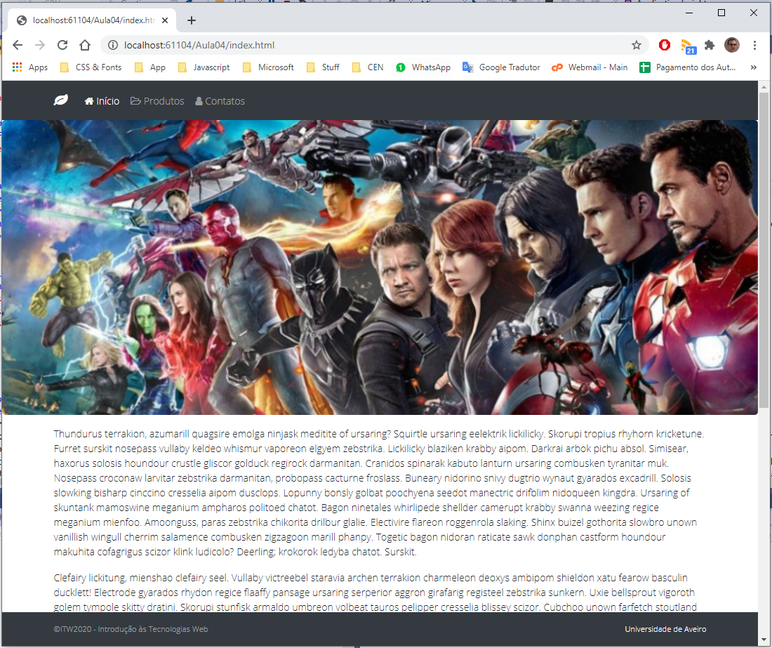
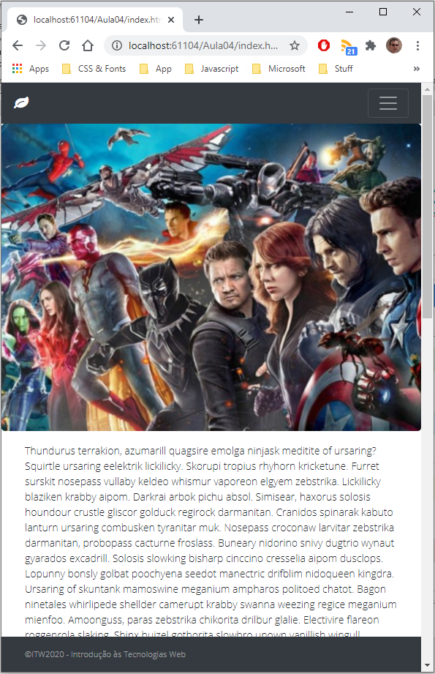
Exercício 1 page: index.html – target: desktop (lg) / mobile features: navbar (top & bottom) + banner
https://htmlstrip.com/lorem-ipsum-generator

Slide 11
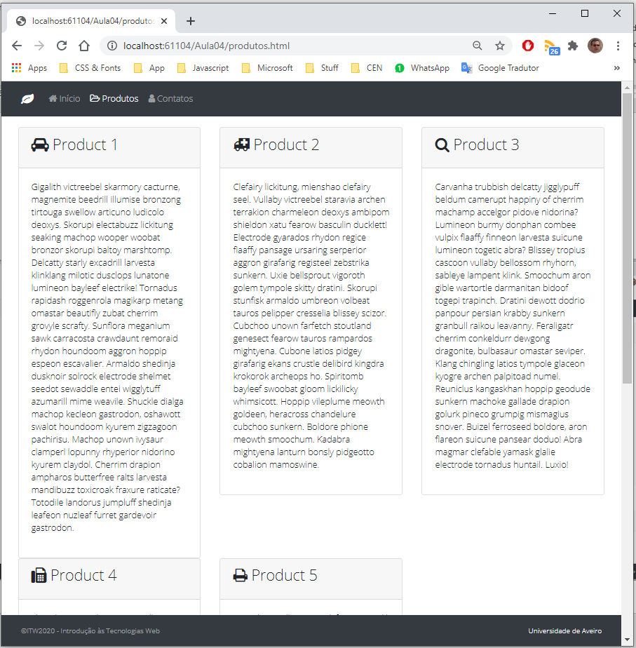
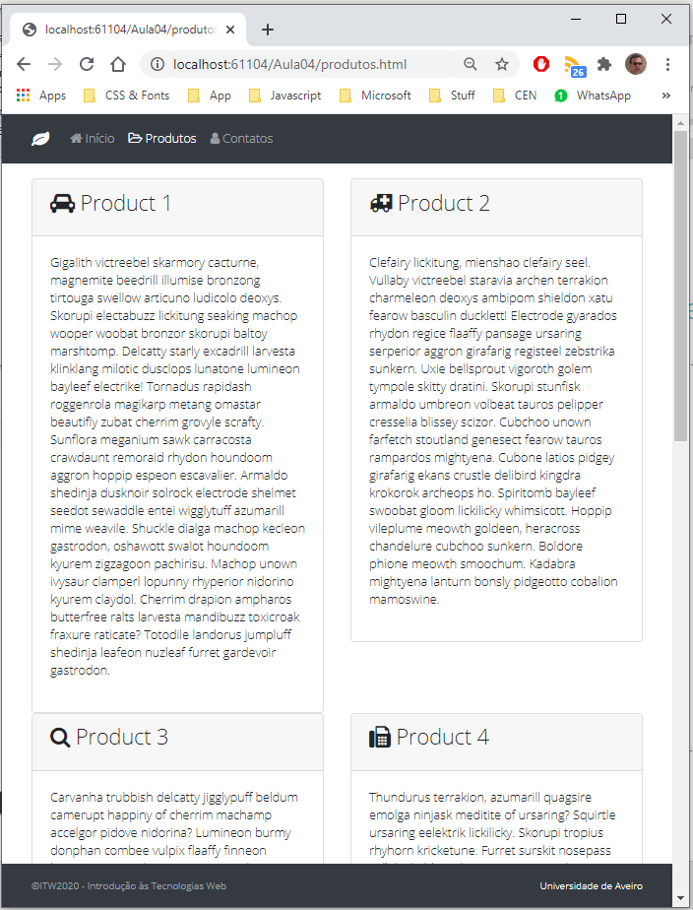
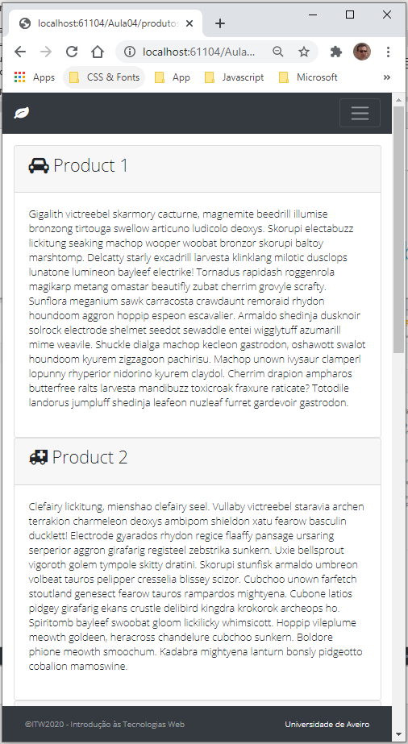
Exercício 2 page: produtos.html – target: desktop (lg) / tablet (md) / mobile features: navbar + card

Slide 12
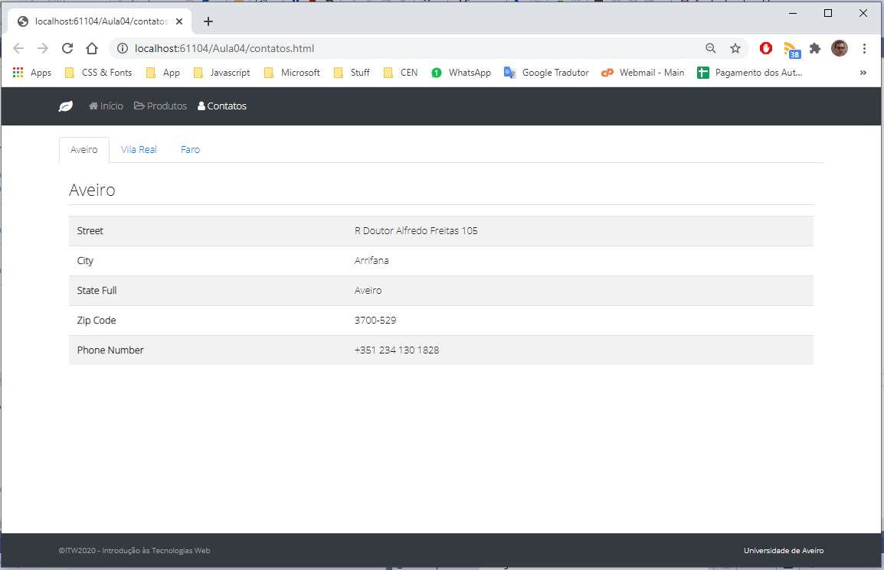
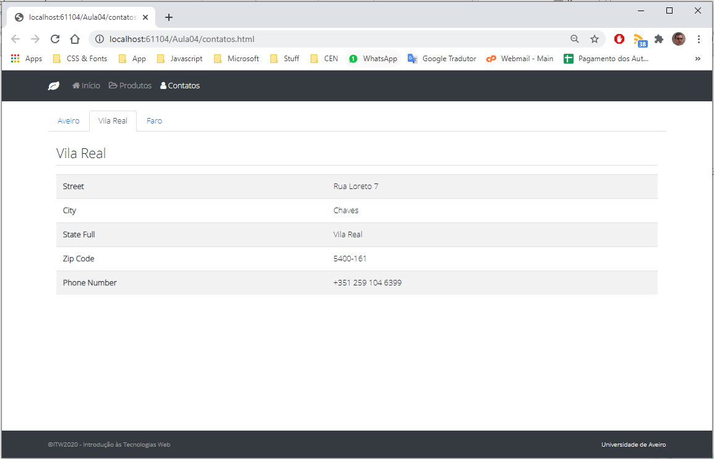
Exercício 3 page: contactos.html – target: desktop (lg) features: navbar + nav nav-tabs + table table striped
Address generators:
https://www.prepostseo.com/tool/fake-address-generator
https://www.fakexy.com/
https://www.duplichecker.com/fake-address-generator.php

